Slide 1
Real-Time Anomaly Detection in
Financial Transactions
Presented by:
Deenadayalan R

Slide 2
Objective:
The main goal of this project is to develop an unsupervised anomaly detection system that can identify fraudulent financial transactions in real time.
In financial systems, fraudulent transactions are very rare compared to normal ones, making the dataset highly imbalanced.
Traditional classification methods often fail in such cases.
Hence, this project aims to detect anomalies without relying on prior fraud labels by learning normal transaction behavior and identifying outliers as potential frauds.

Slide 3
Tools and Technologies Used
Languages & Libraries:
Python
NumPy, Pandas – for data manipulation
Scikit-learn – for model building
Flask – for real-time API deployment
Joblib – for model persistence
Dataset:
Kaggle – Credit Card Fraud Detection Dataset
(contains anonymized transaction data: V1–V28, Amount, and Class)

Slide 4
Methodology / Workflow
The project follows a step-by-step workflow to detect anomalies in financial transactions.
1. Data Collection:
  The dataset is obtained from Kaggle’s Credit Card Fraud Detection dataset, which includes real transaction data with anonymized features.
2. Data Preprocessing:
The data is cleaned and scaled using StandardScaler or RobustScaler to reduce sensitivity to outliers.
The features like “Time” and “Class” are removed during training, as the system learns patterns of normal transactions only.
3. Model Building:
Two unsupervised models are used and compared:
Isolation Forest: Efficiently isolates anomalies by randomly partitioning data.
Local Outlier Factor (LOF): Measures local deviation and density to find anomalies.
4. Model Evaluation:
The models are tested based on metrics such as Precision, Recall, and F1-score.
The aim is to maximize Recall (catching more frauds) while maintaining good Precision (reducing false positives).
5. Threshold Tuning:
Thresholds are tuned to achieve the best balance between detecting true frauds and minimizing false alarms.
6. Deployment:
A Flask-based web API is built that accepts transaction details in JSON format and returns whether the transaction is normal or fraudulent.
This simulates a real-time fraud detection environment.
Workflow Summary:
Data → Preprocessing → Model Training → Evaluation → API Deployment → Real-Time Prediction

Slide 5
Implementation Details
The implementation is done in Python and divided into two parts — model training and deployment.
Model Training:
The dataset is loaded using Pandas.
Data is scaled and split into training and testing sets.
The Isolation Forest algorithm is trained on the data to detect outliers.
The model and scaler are saved using Joblib for later use.
Deployment:
A Flask web server is created to serve the model.
The server provides an endpoint “/predict” that accepts JSON input containing transaction details.
The input data is scaled using the saved scaler, and the model predicts whether the transaction is normal or fraudulent.
The result is returned as a JSON response in real time.
Model Output:
“0” indicates a normal transaction.
“1” indicates a fraudulent transaction.

Slide 6
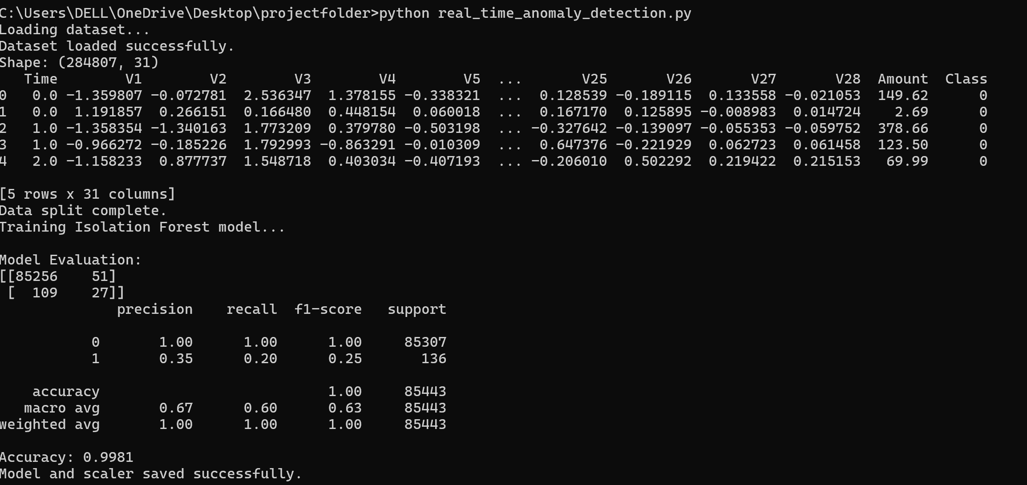
Output and Results
The model successfully identifies anomalies representing fraudulent transactions.
Output Observations:
The Isolation Forest achieved a high recall value, meaning it could detect most fraud cases.
The Local Outlier Factor model was also effective but slightly slower compared to Isolation Forest.
The model correctly classified most transactions, with very few false positives.

Slide 7
Conclusion
Project Summary:
This project demonstrates how unsupervised learning can be effectively applied to detect fraudulent transactions in real time.
By using Isolation Forest and Local Outlier Factor, the system learns normal transaction behavior and identifies anomalies as potential frauds.
The Flask web application provides real-time predictions for new transactions, simulating a real-world fraud detection system.

